Slide 1
Tile2Net Inspector
Zehao Liu zl6194

Slide 2
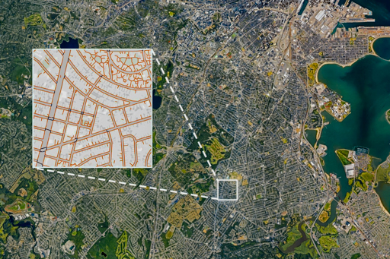
Introduction & Motivation
We already have a model called Tile2Net that predicts roads as line segments. But it’s hard to tell where it works well and where it fails just by looking at the raw shapefiles.
The goal is to assess the topological and geometric quality of the final pedestrian network graph

Slide 3
Introduction & Motivation (cont.)
So I built this web tool to:
Automatically run the model for a given location
Load OpenStreetMap data as ground truth
Compute graph metrics (IoU, precision, recall, F1, MDE)
Visualize TP/FP/FN directly on the map
Provide tile-level and network-level analysis

Slide 4
Pipeline / Backend Logic
User inputs location
The backend runs the Tile2Net pipeline, downloads satellite tiles if they don’t exists, runs Tile2Net inference if the predictions are missing.
Loads the predicted road network from shapefiles.
Downloads OpenStreetMap data with osmnx and converts it to GeoDataFrame.
Computes metrics comparing prediction and ground truth.

Slide 5
Pipeline / Backend Logic (cont.)
6. Generate GeoJSON layers:
- True positive – predicted roads close to a real road
- False positive – predicted roads with no real road nearby
- False negative – real roads that the model missed
7. Interactive visualization (Leaflet + D3)

Slide 6
Metrics Explained
IoU = intersection / union
If prediction perfectly overlaps the true road, IoU is close to 1.
If they barely overlap, IoU goes towards 0.
Precision = intersection area / predicted area
Of all predicted roads, what fraction actually matches a real road?
Recall = intersection area / ground-truth area
Of all real roads, what fraction is recovered by the model?
F1 score = 2 × (precision × recall) / (precision + recall)
Balances precision and recall

Slide 7
Metrics Explained (cont.)
MDE (Mean Displacement Error): for each ground-truth road and each predicted road, we measure how far they are from each other and average these distances.
On average, how far are the predicted roads displaced from the real roads?
A smaller MDE means the predicted network lies very close to the real network.

Slide 8
Metrics Explained (cont.)
DISTANCE THRESHOLD (M) = 5 meters is used when we classifiy True Positive / False Positive / False Negative
A predicted road is True Positive if it is within 5 meters of some ground-truth road.
It is False Positive if it’s farther than 5 meters from any real road.
A ground-truth road is False Negative if there is no predicted road within 5 meters.

Slide 9
Metrics Explained (cont.)
Components
A component = a connected subgraph
If the model misses connections, components increase
Connectivity Ratio
= size of the largest component / total nodes
Shows how “globally connected” the predicted network is

Slide 10
Metrics Explained (cont.)
Isolated Segments
Small components of size 1–2
Often come from noisy predicted lines
Dead-end Ratio
dead ends / all nodes
Fragmented network

Slide 11
How Networks and Topology Are Computed
Extracting Networks
Tile2Net outputs skeletonized masks
Converted into LineString GeoJSON
Combine everything into one predicted network layer
Dead Ends & Intersections
Convert network into graph nodes
Count node degree:
degree = 1 → dead end
degree ≥ 3 → intersection

Slide 12
How the Tool Looks

Slide 13
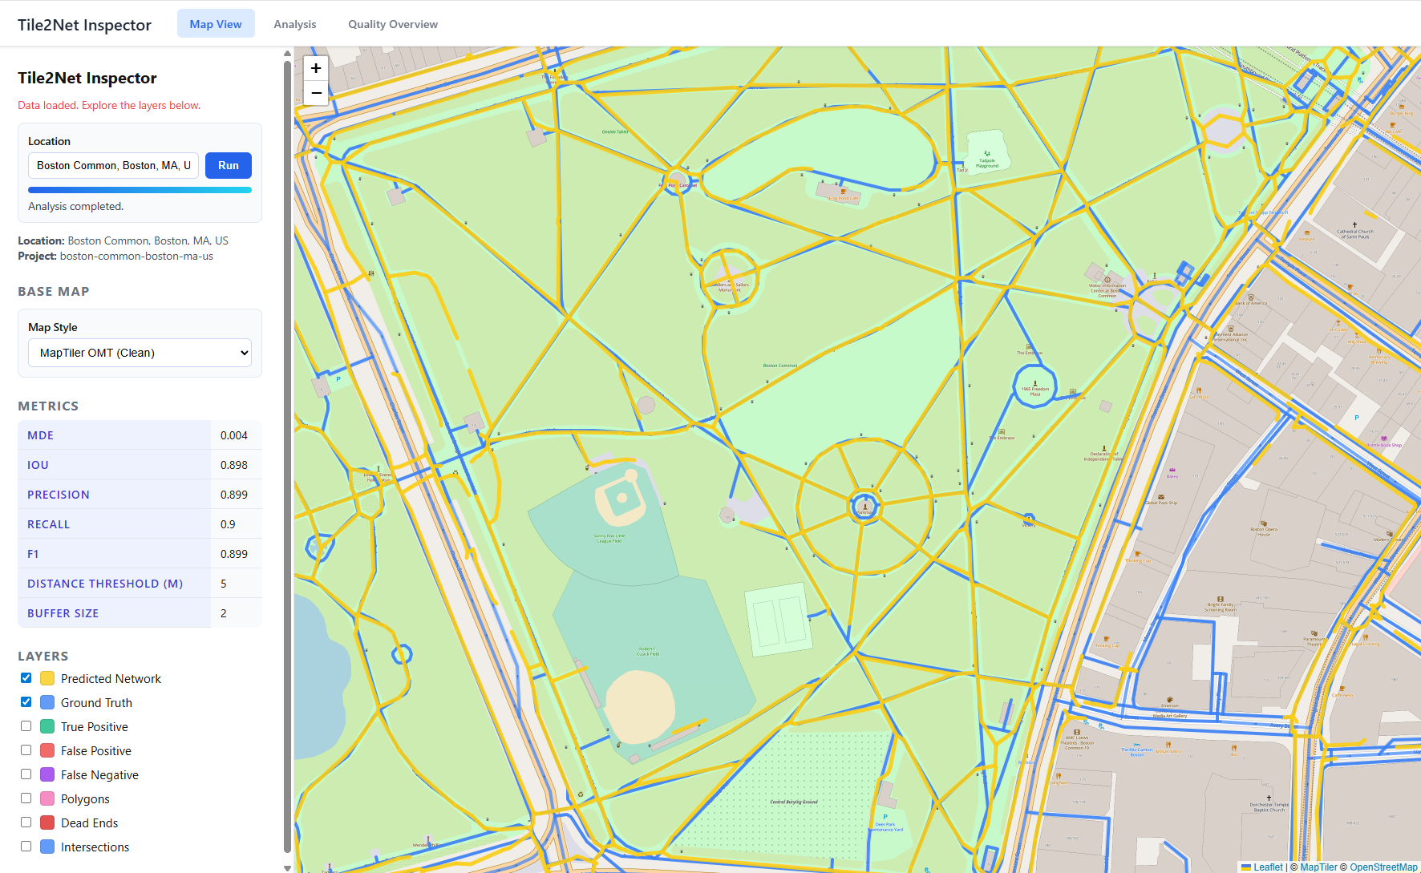

Slide 14
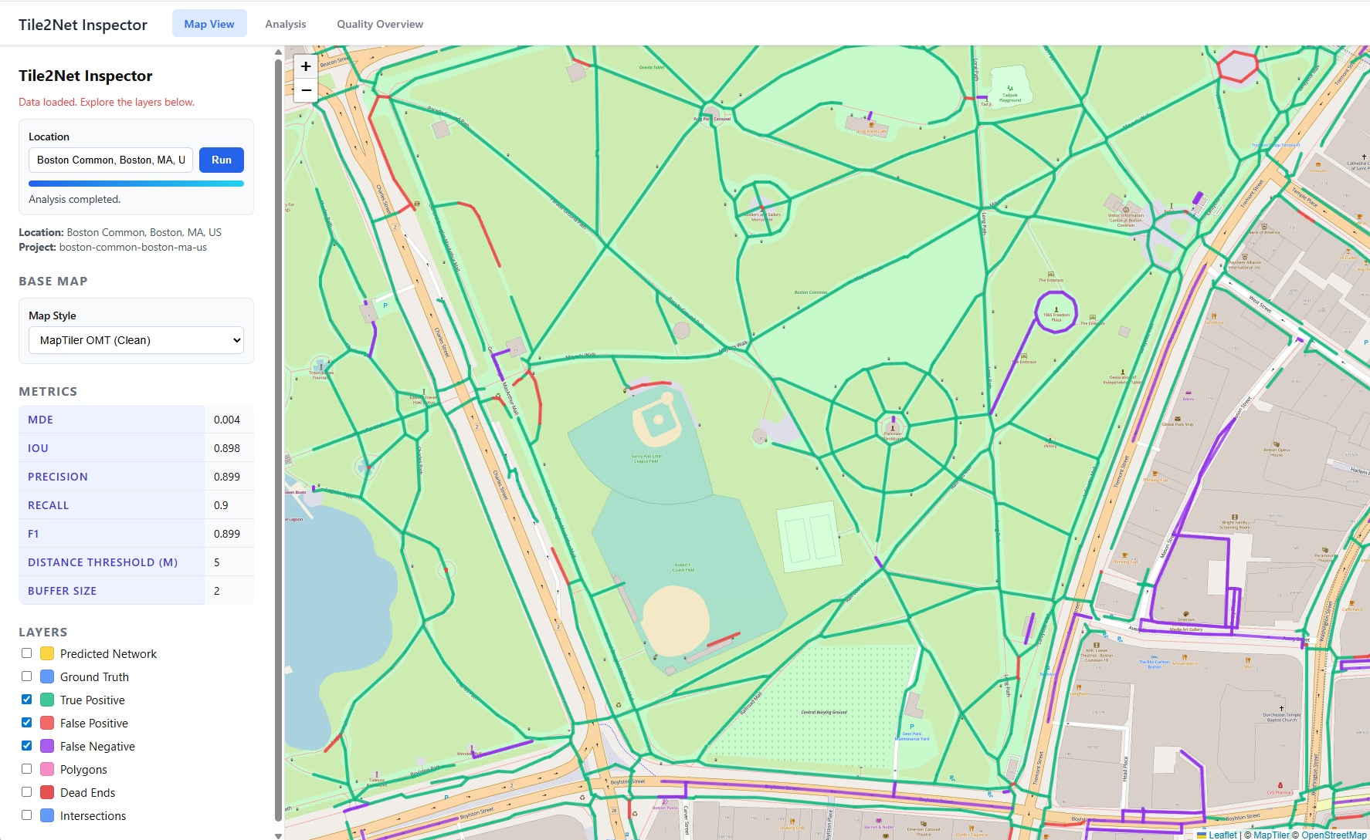

Slide 15
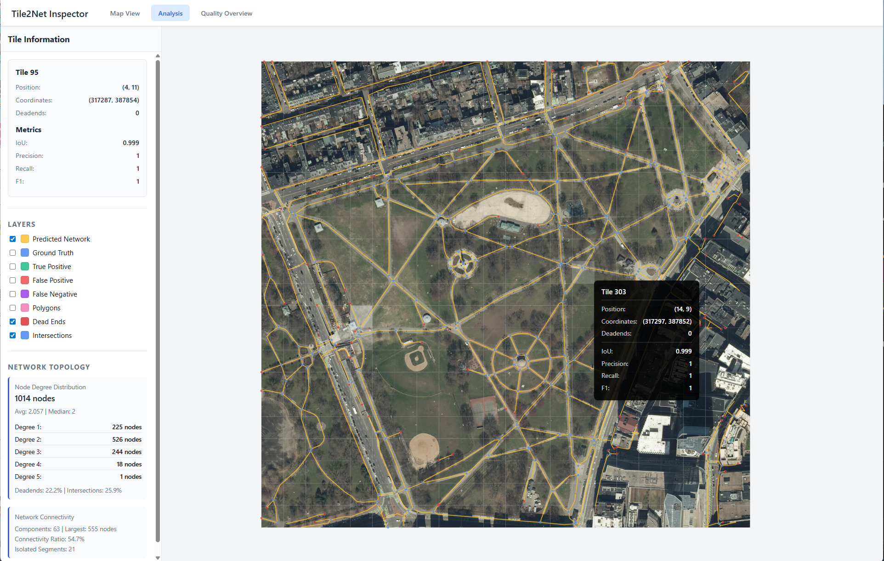

Slide 16
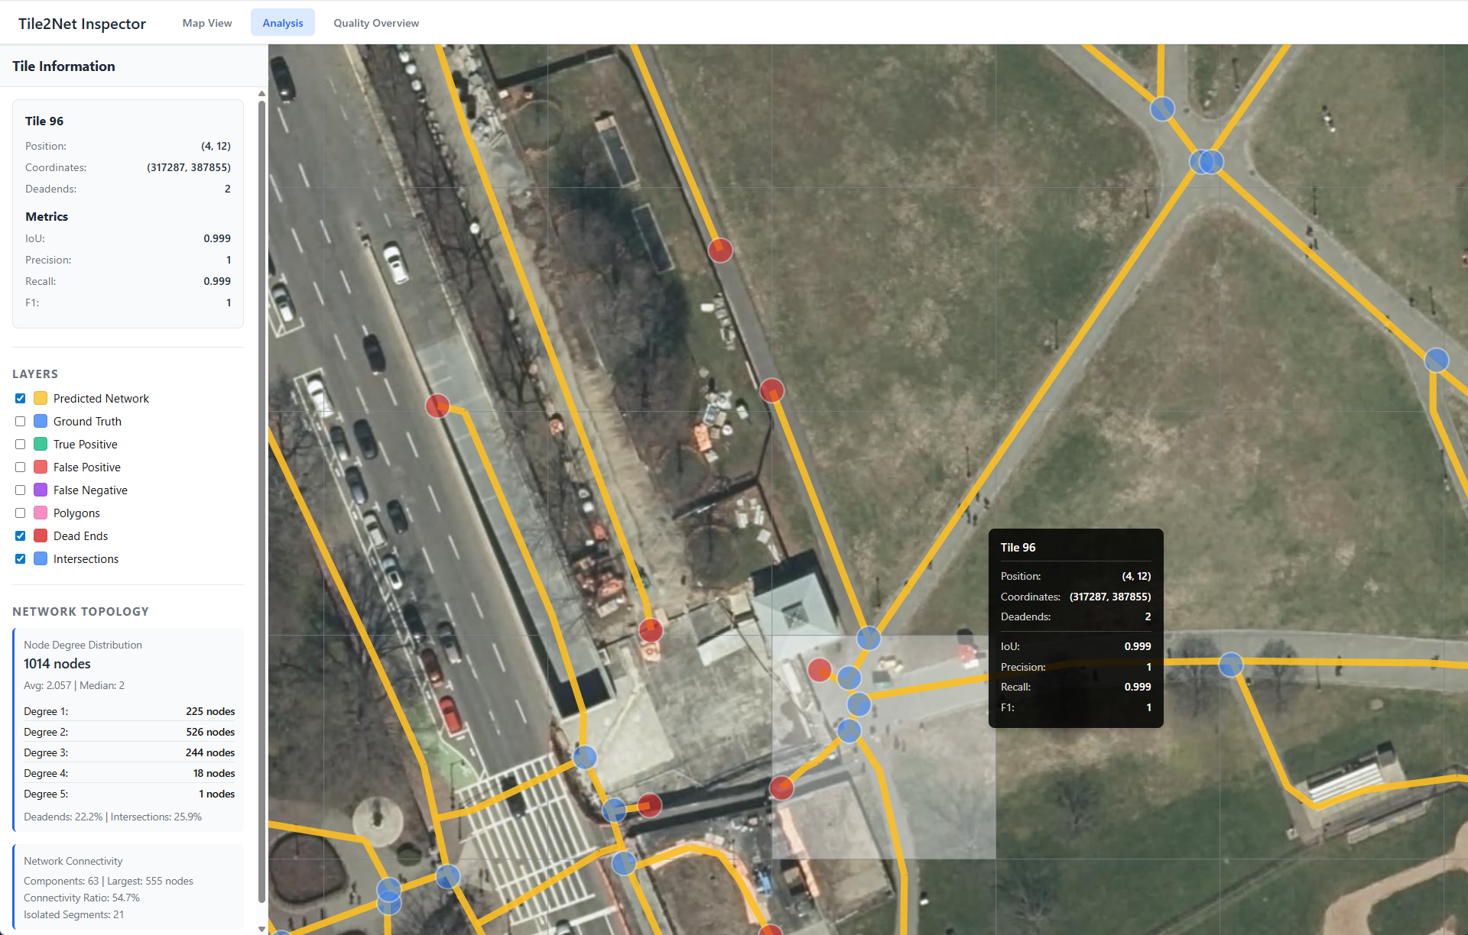

Slide 17
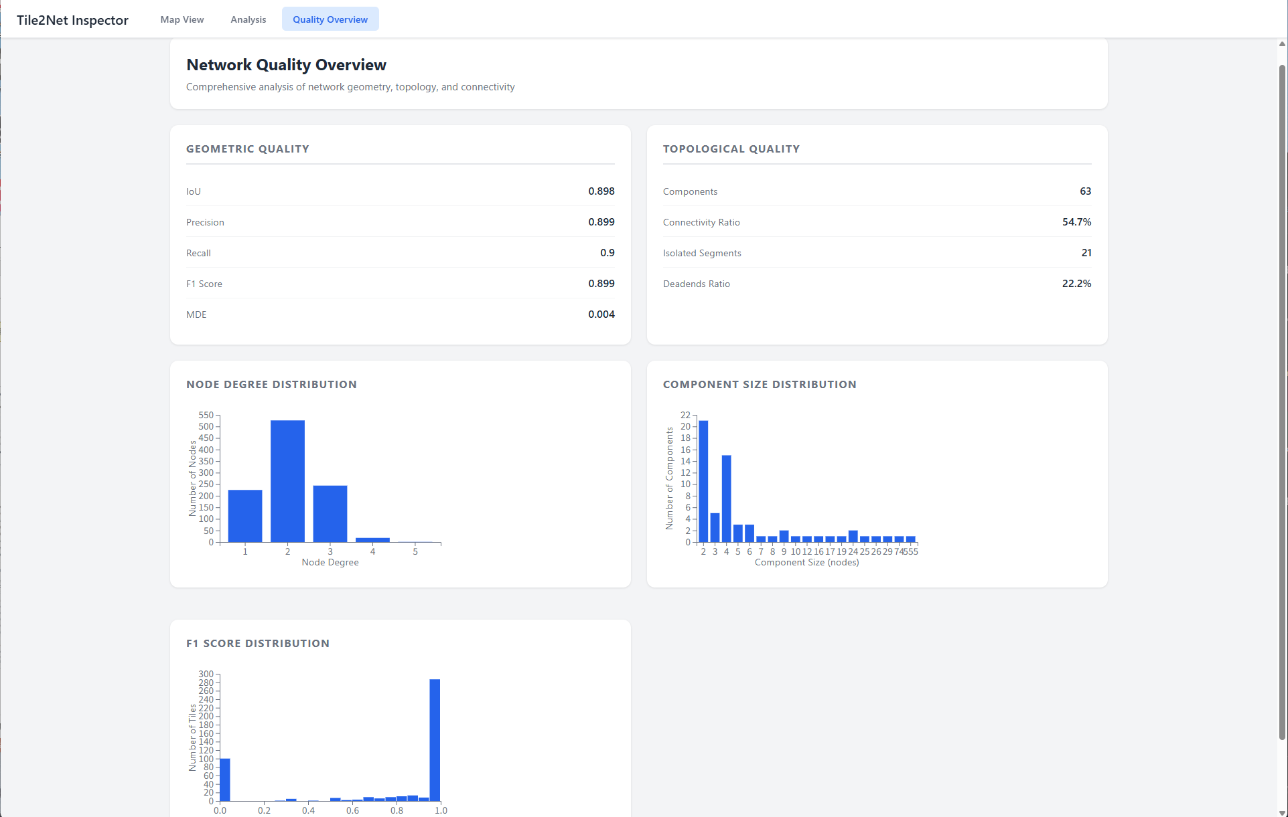

Slide 18
Reference
VIDA-NYU, “GitHub - VIDA-NYU/tile2net: Automated mapping of pedestrian networks from aerial imagery tiles,” GitHub, 2025. https://github.com/VIDA-NYU/tile2net (accessed Nov. 28, 2025).

Slide 19
Thank you for listening!

